Slide 1
Compilors and Interpretors and Generation of Languages
By
Assist Prof Asma Khan

Slide 2
Compiler Verses Interpreter
A compiler is a translator which transforms source language (high-level language) into object language (machine language). In contrast with a compiler, an interpreter is a program which imitates the execution of programs written in a source language. Another difference between Compiler and interpreter is that Compiler converts the whole program in one go on the other hand Interpreter converts the program by taking a single line at a time.
A language translator is a software which translates the programs from a source language that are in human-readable form into an equivalent program in an object language. The source language is generally a high-level programming language, and the object language is typically the machine language of an actual computer.

Slide 3
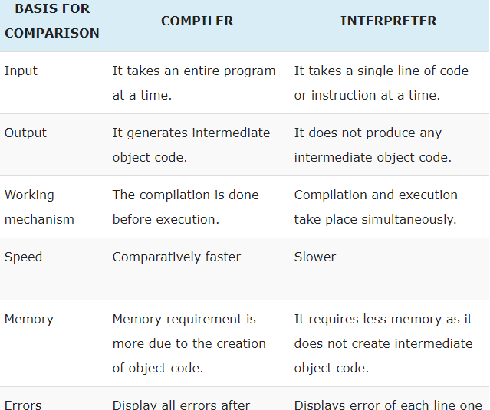
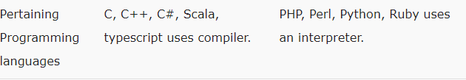

Slide 4
